Slide 1
Programming Language Concepts
Chapter 1: Preliminaries

Slide 2

Admission Ticket
For languages we will cover , you are given a ticket. We can’t possibly cover everything you need to know, but we have allowed you admittance to the “show”.
You know the debugger. You can run hello world. You understand key differences. You know where the documentation is. What you do with your admission ticket is up to you!

Slide 3
Housekeeping Stuff
Reading Material
Textbook
  Programming Languages: Principles and Practice by Kenneth C. Louden, PWD Publishing Company, 2003
Course Website
  Lectures are available on the course website before the lecture
  Assignments will be available on the course website
  As much as is practical this will be a paper free course
Check the Course Web Site regularly

Slide 4
Goals of Course
  Syntax indicates structure of program code
    How can language designer specify this?
    How can programmer learn language?
    How can compiler recognize this?
      Lexical analysis
      Parsing (syntax analysis)
        Brief discussing of parsing techniques
  Semantics indicate meaning of the code
    What code will actually do
    Can we effectively do this in a formal way?
      Static semantics
      Dynamic semantics

Slide 5
Goals of Course
To examine some language features and constructs and how they are used and implemented in various languages
  Variables and constants
    Types, binding and type checking
    Scope and lifetime
  Data Types
    Primitive types
    Array types
    Structured data types
    Pointer (reference) types

Slide 6
Goals of Course
  Assignment statements and expressions
    Operators, precedence and associativity
    Type coercions and conversions
    Boolean expressions and short-circuit evaluation
  Control statements
    Selection
    Iteration
    Unconditional branching – goto

Slide 7
Goals of Course
  Process abstraction: procedures and functions
    Parameters and parameter-passing
    Generic subprograms
    Non-local environments and side-effects
    Implementing subprograms
      Subprograms in static-scoped languages
      Subprograms in dynamic-scoped languages

Slide 8
Goals of course
  Data abstraction and abstract data types
  Object-oriented programming
    Design issues
    Implementations in various object-oriented languages
  Concurrency
    Concurrency issues
    Subprogram level concurrency
      Implementations in various languages
    Statement level concurrency

Slide 9
Goals of Course
  Exception handling
    Issues and implementations
  Functional programming languages
  Logic programming languages

Slide 10
Course Motivation
Why are programming languages the way they are?
How are particular language features implemented /supported?
understand the underlying ideas of the main programming paradigms
know more about the huge variety of programming languages
understand how the syntax and semantics of languages can be defined precisely.
know how important features are supported
have a deeper understanding of the history and rationale behind languages like C++.

Slide 11
Course Outline
Overview and History
Syntax and Parsing
Data Types
Control Structures ???
Functional Languages Issues
Logic Programming
Object-Oriented Language Issues

Slide 12
The Problem
Computers - fast, accurate and never get tired, but not intelligent (no ability to reason or solve problems without instruction)
Humans – relatively intelligent, but slow & error prone at repetitive tasks, require periodic sleep
Use the computer as another tool
  The wheel, wedge, fulcrum … slide rule … computer
How do we take our knowledge of how to solve problems and transfer the instructions into a computer so we can use it as a tool?

Slide 13
Instructing a Computer
Can we …
  Talk to a computer with natural language?
  Draw pictures for the computer?
  Instruct a computer to observe and reason about what it should do next?
Yes, to some extent, but …
For now, these are further abstractions enabled by programming languages
Which are abstractions on top of machine language

Slide 14
Why study programming languages?
Increased capacity to express ideas
Improved background for choosing appropriate languages
Increased ability to learn new languages
Better understanding of the significance of implementation
Increased ability to design new languages
Overall advancement of computing

Slide 15
Increased capacity to express ideas
Programming language constrains
  Control structures
  Data structures
  Abstractions that can be used
Awareness of language features reduces these limitations
  Features of one language may be simulated in another
  Study of PLC builds appreciation for language features and encourages their use

Slide 16
Improved background for choosing languages
Many programmers have had little formal CS training or training in the distant past
Programmers tend to use what they are familiar with, even if it is not suitable for the task
Familiarity with variety of languages allows for more informed language choices

Slide 17
Ability to learn new languages
A thorough understanding of PLC makes it easier to see how language concepts are incorporated in the language being learned
  Understanding data abstraction facilitates learning how to construct ADTs in C++ or Java
  Understanding PLC terminology makes it easier to understand manuals for programming languages and compilers

Slide 18
Understanding implementation
Understanding language implementation issues leads to
  Understanding why languages are designed the way they are
  Ability to use a language more intelligently
  Ability to use a language more efficiently when there is a choice among several constructs:
    Example: recursion vs. iteration

Slide 19
Designing new languages
Programmers occasionally design languages of some kind or another
  Software system user interface
    Interface design involves PLC techniques
      Lexical analysis
      Parsing
    Criteria for judging user interface are similar to language design criteria
  Language design influences complexity of the algorithms that translate it

Slide 20
Overall advancement of computing
Why does a particular language become popular?
  Best suited to solving problems in a particular domain
  Those in positions to choose are familiar with PLC
  Those in positions to choose are not familiar with PLC
ALGOL 60 vs FORTRAN (1960s)
  ALGOL more elegant, better control statements
  Programmers found ALGOL language description difficult to read, concepts difficult to understand

Slide 21
Programming Domains
Scientific Apps
  FORTRAN, ALGOL
Business Apps
  COBOL
A.I.
  LISP, Prolog
Systems Programming
Scripting Languages
  sh, awk, Perl
Special Purpose Languages

Slide 22

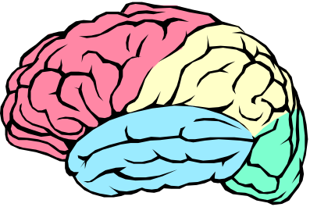

Programming Languages
What is a programming language?
Programming Language

Slide 23
Programming Languages
What is a programming language?
  Abstraction of virtual machine
int sum(int[] x) {
int sum = 0;
n = 0;
while (n < x.length) {
sum += x[n];
}
return sum;
}
00101010101010
10101011111010
11101010101110
00101010101010
...

Slide 24
Programming Languages
What is a programming language?
  Donald Knuth:
    Programming is the art of telling another human being what one wants the computer to do
int sum(int[] x) {
int sum = 0;
n = 0;
while (n < x.length) {
sum += x[n];
}
return sum;
}
00101010101010
10101011111010
11101010101110
00101010101010
...

Slide 25
The human-computer semantic gap
Human:
Interested in modeling the real world
More interested in what computer should do than how
Computer:
Only data it can manipulate is sequences of zeros and ones.
Understands low-level “how” instructions.

Slide 26
What are programming languages…
High-level languages bridge the human-computer semantic gap by providing a higher level notation that can still be executed by computer

Slide 27
What is a Programming Language?
Definition: A programming language is a notational system for describing computation in machine-readable and human-readable form.
Set of abstractions => virtual machine
A way of thinking

Slide 28
Computation
Computation:Anything that a computer can do
  i.e. anything that is computable (by a Turing Machine)
Described by a Turing Machine - a very simple computer that can carry out all known computations (albeit not very efficiently).
A programming language is Turing complete if it can be used to describe any computation performed by a Turing Machine.
To be useful a programming language must interface to all the hardware devices and software packages that we need to use.

Slide 29
Language Implementation
Language definition
  syntax, semantics
Language translation

Slide 30
What is needed for Turing completeness?
Virtually nothing:
  A programming language is Turing complete provided it has
    integer variables and
    arithmetic and
    sequentially executes statements, which include assignment, selection (if) and loop (while) statements.
Even if statements are unnecessary

Slide 31
Machine-readability
Also not a huge requirement:
  Basically, the existence of a (more or less) linear-time translation algorithm.
Usually boils down to:
The syntax must be given by a context-free grammar.
The language must have a fixed syntax so that machine (computer) can read/parse programs.
The language must have a fixed semantics so the computer knows what a program means and can execute it.

Slide 32
Human-readability:
This is the real issue!
Virtually all the complex details of a programming language are there to (supposedly) enhance human readability.
Still not very well understood.
Is strongly dependent on good choice of abstractions.
Or preferably, human understandable
Much harder for larger programs
The main challenge is controlling complexity
  main tool abstraction
The extent to which a programming language supports/enforces abstraction is an important issue

Slide 33
What about human “writability?”
Aren’t programming languages there to promote the writing of programs, not the reading of them?
Nonsense! Writability is a hacker’s goal: Perl is very writable, but try to read it!
Readability is the real goal: many people are going to have to read your program after you have written it.

Slide 34
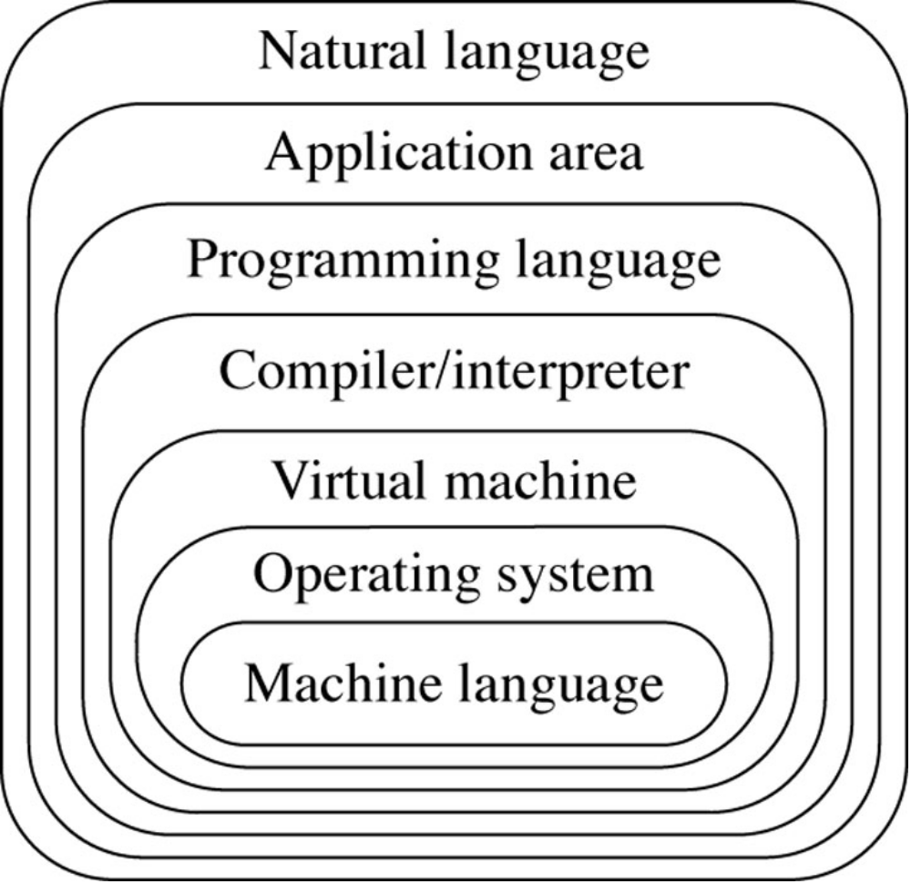
Levels of Language in Computing

Slide 35
Abstractions
Common abstraction that PL provide to express computation.
PLs fall into two categories: Data abstraction and control abstraction.
Data abstractions abstract the properties of the data.
Control abstractions abstract the properties of the transfer of control.

Slide 36
Abstractions
Programming language abstractions fall into two general categories: data abstraction and control abstraction.
Data abstractions abstract properties of the data, such as character strings, numbers, or search trees, which is the subject of computation.
Control abstractions abstract properties of the transfer of control, that is, the modification of the execution path of a program based on the situation at hand. Examples of control abstractions are loops, conditional statements, and procedure calls

Slide 37
Data Abstractions
Basic abstractions.
Basic data abstractions in programming languages abstract the internal representation of common data values in a computer. For example, integer data values are often stored in a computer using a two's complement representation, and standard operations such as addition and multiplication are provided.
Locations in computer memory that contain data values are abstracted by giving them names and are called variables. The kind of data value is also given a name and is called a data type.
Data types of basic data values are usually given names that are variations of their corresponding mathematical values, such as int or integer and real or float. Variables are given names and data types using a declaration, such as the Pascal: var x : integer; or in C++ int x;

Slide 38
Structured abstractions
The data structure is the principal method for abstracting collections of data values that are related.
For example, an employee record may consist of a name, address, phone number, and salary, each of which may be a different data type, but together represent the record as a whole.
Another example is that of a group of items, all of which have the same data type and which need to be kept together for purposes of sorting or searching. A typical data structure provided by programming languages is the array, which collects data into a sequence of individually indexed items.

Slide 39
Unit abstractions
In a large program, it is useful and even necessary to collect related code into specific locations within a program, either as separate files or as separate language structures within a file.
Typically such abstractions include access conventions and restrictions, which traditionally have been referred to as data encapsulation and information hiding. These mechanisms vary widely from language to language, but are often associated with structured types in some way, and thus are related (but not identical) to abstract data types.
Examples include the module of ML and Haskell, and the package of Ada and Java. A somewhat

Slide 40
Unit abstractions
intermediate abstraction more closely related to abstract data types is the class mechanism of object-oriented languages, which could be categorized as either a structured abstraction or a unit abstraction (or both), depending on the language. Classes generally offer data encapsulation and possibly also information hiding, and may also have some of the characteristics of modules or packages

Slide 41
Control Abstractions -Basic abstractions
Typical basic control abstractions are those statements in a language that combine a few machine instructions into a more understandable abstract statement.
We have already mentioned the assignment statement as a typical instruction that abstracts the computation and storage of a value into the location given by a variable, as for example:
  x = x + 3
Another typical basic control statement is the goto statement, which abstracts the jump operation of a computer or the transfer of control to a statement elsewhere in a program, such as the FORTRAN :
  GOTO 10
  C this part skipped
  . . .
  C control goes here
  10 CONTINUE

Slide 42
Basic abstractions
Structured looping mechanisms come in many forms, including the while, for, and do loops of C and C++, the repeat loops of Pascal, and the loop statement of Ada. For example, the following program fragments, first in C and then Ada, both compute x to be the greatest common divisor of u and v using Euclid's algorithm (for example, the greatest common divisor of 8 and 20 is 4, and the greatest common divisor of 3 and 11 is 1):

Slide 43
/* C example */
x = u; y = v;
while (y != 0) /_x0017_ not equal in C */
{ t = y;
y = x % y; /* the integer remainder operation in C */
x = t; }
-- Ada example
x := u; y := v;
loop
exit when y = 0;
t := y; y := x mod y; -- modulo, similar to % in C
x := t;
end loop;

Slide 44
Structured abstractions
Structured control abstractions divide a program into groups of instructions that are nested within tests that govern their execution. Typical examples are selection statements such as the if-statement of many languages, the case-statement of Pascal, and the switch-statement of C. For example, in the following C code,
if (x > 0) { numSolns = 2;
r1 = sqrt (x); r2 = _x0013_ r1; }
else
{ numSolns = 0; }
Ada goes one step farther in structured control, in that the opening of a group of nested statements is automatic and does not require a "begin":
if x > 0.0 then
numSolns := 2;
r1 := sqrt(x);
r2 := -r1;
else
numSolns := 0;
end if;

Slide 45
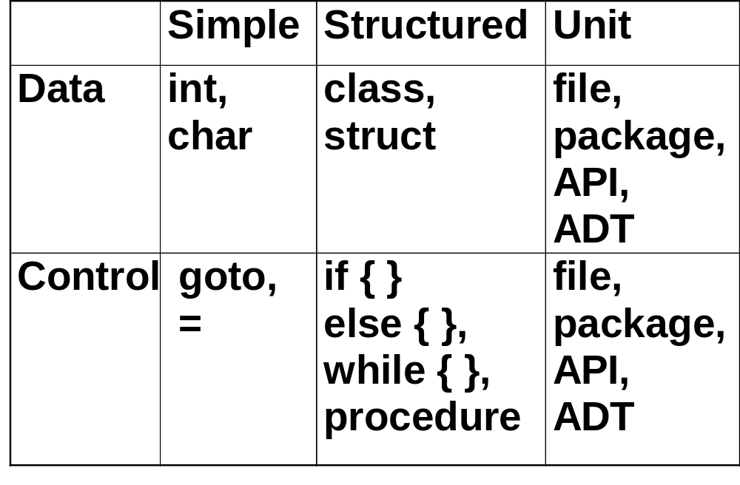
Abstractions:

Slide 46
Computational Paradigms
Programming languages began by imitating the operations of a computer.
It is not surprising that the kind of computer for which they were written had significant effect on their design.
  variables representing memory
  assignment to change values
  sequential execution of statements

Slide 47
Variables can be given a data structure in a declaration, as in the C:
  int a[10]; or the FORTRAN INTEGER a(10)
which establish the variable a as containing an array of ten integer values. Data structures can also be viewed as new data types that are not internal, but are constructed by the programmer as needed. In many languages these types can also be given type names, just as the basic types, and this is done in a type declaration, such as the C:
  typedef int Intarray[10];
  which defines the new name Intarray for the type array of integer, with space for ten values. Such data types are called structured types.

Slide 48
Language Paradigms
Imperative (procedural): How the computer should do it
  traditional sequential programming (passive data, active control). Characterized by variables, assignment, and loops.
Object-oriented: data-centric, data controls its own use, action by request to data objects. Characterized by messages, instance variables, and protection. Extension of imperative paradigm.
Functional: passive data, but no sequential control; all action by function evaluation (“call”), particularly recursion. No local variables! ~ to mathematics

Slide 49
Language Paradigms (cont.)
Logic: Assertions are the basic data; logic inference the basic control. Again, no sequential operation. ~ to mathematics
ex: I am your sister if I am female and we have common parents.
Parallel: well, maybe not really a paradigm, but some think so. Again, no sequential operation.
“Declarative”: How the computer should do it
  Logic and functional paradigms share this property: state “what” needs computing, not “how” (sequence).

Slide 50
Languages and paradigms
Imperative: C, Pascal, core Ada, FORTRAN
Functional: Lisp (Scheme), ML, Haskell
Object-oriented: C++, Java, Smalltalk
Logic: Prolog
Parallel: Java (threads), Ada (tasks)

Slide 51
Are functional languages Turing-complete?
Previous theorem on Turing-completeness depends on the existence of variables and loops.
Functional programs do not have variables or loops. Can all computation be expressed?
Yes!:
  A programming language is Turing complete if it has integer values, arithmetic functions on those values, and if it has a mechanism for defining new functions using existing functions, selection, and recursion.

Slide 52
Paradigm use is rarely “pure”:
The C program (in text)defined gcd function in a purely functional style, even though C is mainly imperative.
The Java program used some imperative code to compute the gcd, and was not completely object-oriented (integers aren’t objects).
The Scheme code used sequencing to do I/O, an imperative feature.

Slide 53
Examples of languages that are pure (mostly)
Imperative: (old) FORTRAN
Functional: Haskell
Object-oriented: Smalltalk

Slide 54
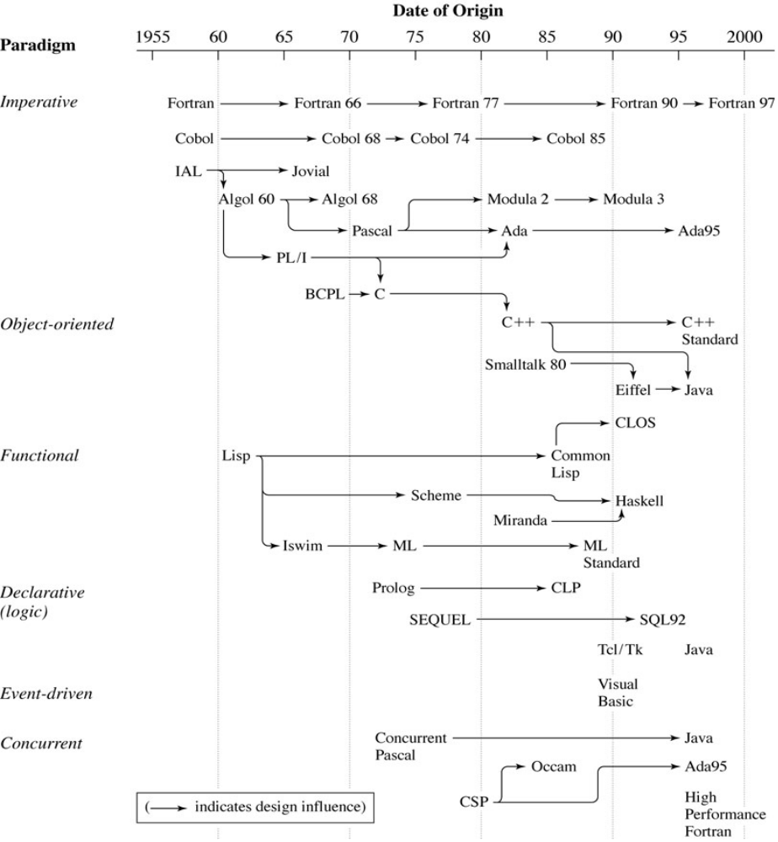
A Brief Historical Lineage of Some
Key Programming Languages

Slide 55
Program Language Qualities:
Simplicity and Clarity.
  How hard is it to write, or read, programs in the language?
  Is it easy to learn the language?
  Basic, Pascal, and Algol, maybe C but not APL.
Binding.
  Properties are bound to language elements at different times.
  Compile time, load time, run time, etc.
  Early binding vs. late binding.
Othogonality.
  Do symbols and reserve words always mean the same thing?
  Do basic features interact in a predictable way?
  Do bindings change, are operators overloaded?

Slide 56
Program Language Qualities:
Reliability.
  Does the program behave differently on different platforms?
  Is it easy to validate a program (unambiguous semantics)?
Applicability.
  What problem domain was the language written to address?
  One size does not fit all!
Abstraction.
  Support for code reuse?
  Standard functions and class libraries.
Efficient Implementation.
  A language is not very useful if you can’t implement it.
  Does it meet the needs of its application domain?

Slide 57
Language definition
Syntax: the structure of a program. Usually given a formal (i.e., mathematical) definition using a context-free language. (Lexical structure - the structure of the words or tokens - uses regular expressions.)
Semantics: the actual result of execution. Usually described in English, but can be done mathematically.
Semantics can have a static component: type checking, definition checking, other consistency checks prior to execution.
What are dynamic components of semantics?

Slide 58
Language translation
inputs
source
compiler
executable
run
outputs
Compiler: two-step process that (1) translates source code into target code; then (2) the user executes the target code.

Slide 59
Language translation
inputs
source
run
outputs
Interpreter: one-step process in which the source code is executed directly.
Hybrids are also possible (Java).
inputs
Java
compiler
machine
dependent
interpreter
source
bytecode
outputs
Bytecode is composed of instructions that have been brought to the
lowest level possible without making them machine dependent.

Slide 60
Compilation, Interpretation, and Hybrid systems
Consider this piece of code:
public class Test { public static void main(String args[]) { int i; i = 2; i = i + 7; } }

Slide 61
If we were to compile it, we would change it to machine instructions that would only work for one architecture.
If we were to interpret it, our interpreter would have to be able to understand the high level code AND would repeatedly parse it (if the code was in a loop).
When we use the hybrid approach of Java, we produce the file Test.class, which is a binary file that's not readable by most humans. We can convert the file to a readable form with the javap tool as shown here:

Slide 62
C:\ > javap -c Test
Compiled from Test.java
public class Test extends java.lang.Object {
public Test(); // a default constructor created
public static void main(java.lang.String[]);
}
Method Test()
0 aload_0
1 invokespecial #3
4 return
Method void main(java.lang.String[])
0 iconst_2 // Put integer 2 on stack
1 istore_1 // Store the top stack value at location 1
2 iload_1 // Put the value at location 1 on stack
3 bipush 7 // Put the value 7 on the stack
5 iadd // Add two top stack values together
6 istore_1 // The sum, on top of stack, stored at location 1
7 return // Finished processing

Slide 63
Although the bytecode cannot access registers or directly reference memory locations and must obey various other restrictions, the actual JVM (java virtual machine) program can use internally whatever techniques are convenient to use for a particular platform. As long as the Java bytecode sees only a JVM specification compliant system, the JVM programmer has broad discretion for its implementation

Slide 65
Language Evaluation Criteria
Readability
Writability
Reliability
Cost

Slide 66
Readability
Overall Simplicity
Orthogonality
Control Statements
Data Types and Structures
Syntax Considerations

Slide 67
Readability: Simplicity
The difficulty in learning a new language increases with the number of components in the language
Feature multiplicity negatively impacts readability
  C: x++; ++x; x = x+1; x += 1;
Operator overloading should be used sensibly
Simplicity in the extreme: assembly language

Slide 68
Readability: Orthogonality
A relatively small set of primitive constructs can be combined in a relatively small number of ways to build the control and data structures of the language.
Every possible combinations of primitives is legal and meaningful

Slide 69
Orthogonality
Example: suppose a language has
  4 data types (int, float, double, char)
  2 type operators (array and pointer)
  If the 2 type operators can be applied to themselves and the 4 data types, a large number of data structures is possible.
  int[5][2], float***, float*[4], etch

Slide 70
Orthogonality
The more orthogonal the design, the fewer exceptions the language rules require.
C is not very orthogonal:
  There are 2 kinds of structured data types, arrays and structs; structs can be returned as values of functions, arrays cannot
  Parameters are passed by value, except for arrays, which are passed by reference.

Slide 71
Orthogonality
Too much orthogonality can cause problems, such as ALGOL 68, which had an explosion of combinations
Functional programming languages such as LISP provide a good balance of simplicity and orthogonality
  Single construct, the function call, which can be combined with other function calls in simple ways
  Functions are first-class objects

Slide 72
Readability: Control Statements
Control statements were introduced relatively recently as a reaction to indiscriminate use of goto statements
FORTRAN had no while loop, so while construct was implemented with an IF statement and a restricted GOTO:
20 IF (X .LT. 10) GOTO 30
-- loop statements go here
GOTO 20
30 –- first statement following loop

Slide 73
Readability: Data Types and structures
Features for user-defined data types enhance readability.
Record types for storing employee info vs a collection of related arrays (FORTRAN):
  CHARACTER(LEN=20) NAME(100)
  INTEGER AGE(100)
  INTEGER EMP_NUMBER(100)
  REAL SALARY(100)

Slide 74
Readability: Syntax Considerations
Identifier forms
  FORTRAN 77 (6 chars max, embedded blanks)
  Original ANSI Basic (a single letter, optionally followed by a single digit)
Special words
  Compound statement delimiters
    Pascal: begin..end
    C: { .. }
    Ada: if .. end loop .. end loop

Slide 75
Writability
Simplicity and orthogonality
Support for abstraction
  Process abstraction
  Data abstraction
Expressivity
  APL has powerful operators that accomplish lots of computation with little coding
  for statements for counting loops (instead of while)
  and then, or else Boolean operators in Ada

Slide 76
Reliability
Type checking
  Subscript ranges: Ada vs. C
  Static vs. dynamic type checking
Exception handling
  Intercept runtime errors, take action to correct problem, and continue processing
  PL/I, C++, Ada, Java
Aliasing
  2 or more ways to reference same memory cell
  Possible via pointers, reference parameters, unions

Slide 77
Costs
Training programmers
Writing programs
Compiling programs
Executing programs
Language implementation system
Poor reliability
Maintaining programs

Slide 78
Influences on Language Design
Computer architecture
  Imperative languages model von Neumann architecture
  Functional programming languages need a non-von Neumann architecture to be implemented efficiently
Programming methodologies
  Top-down design, stepwise refinement
  Data-oriented vs. process-oriented design
  Object-oriented design
  Concurrency (process-oriented)

Slide 79
Language Categories
Imperative
Functional
Logic
Object-oriented

Slide 80
Language Design Tradeoffs
Reliability vs. cost of execution
  Ada’s runtime type checking adds to execution overhead
Readability vs. writability
  C and APL
Flexibility vs. safety
  Pascal variant record is a flexible way to view a data object in different ways, but no type checking is done to make it safe

Slide 81
Implementation methods
Compilation
Interpretation
Hybrid implementation systems
  Java applets are compiled into byte code
  Compiled applets are downloaded and interpreted by byte code interpreter

Slide 82
Programming Environments
A collection of tools used in software development
UNIX
Borland C++
Smalltalk
Microsoft Visual C++, Visual Basic

